Slide 1
LINQ and Lambda Expressions

Slide 2
What is LINQ?
List Integrated Query
A SQL-like extension in C# that allows for querying enumerables.
Two ways of using LINQ
Query Syntax
Method Syntax
Both ways are identical, and produce identical results
Just written differently

Slide 3
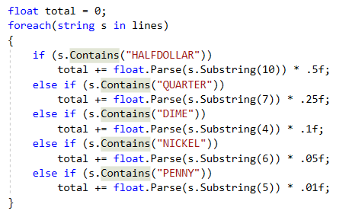
Code without LINQ
From debugging assignment.
Read from file values of currency and determine overall amount.

Slide 4
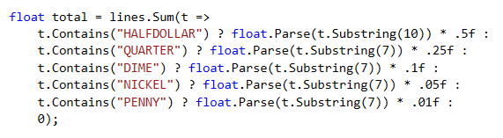
Method Syntax (My preferred)

Slide 5
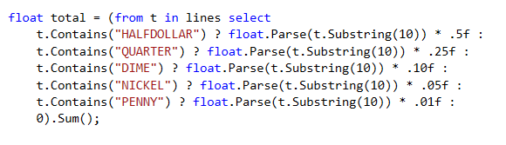
Query Syntax

